Slide 1
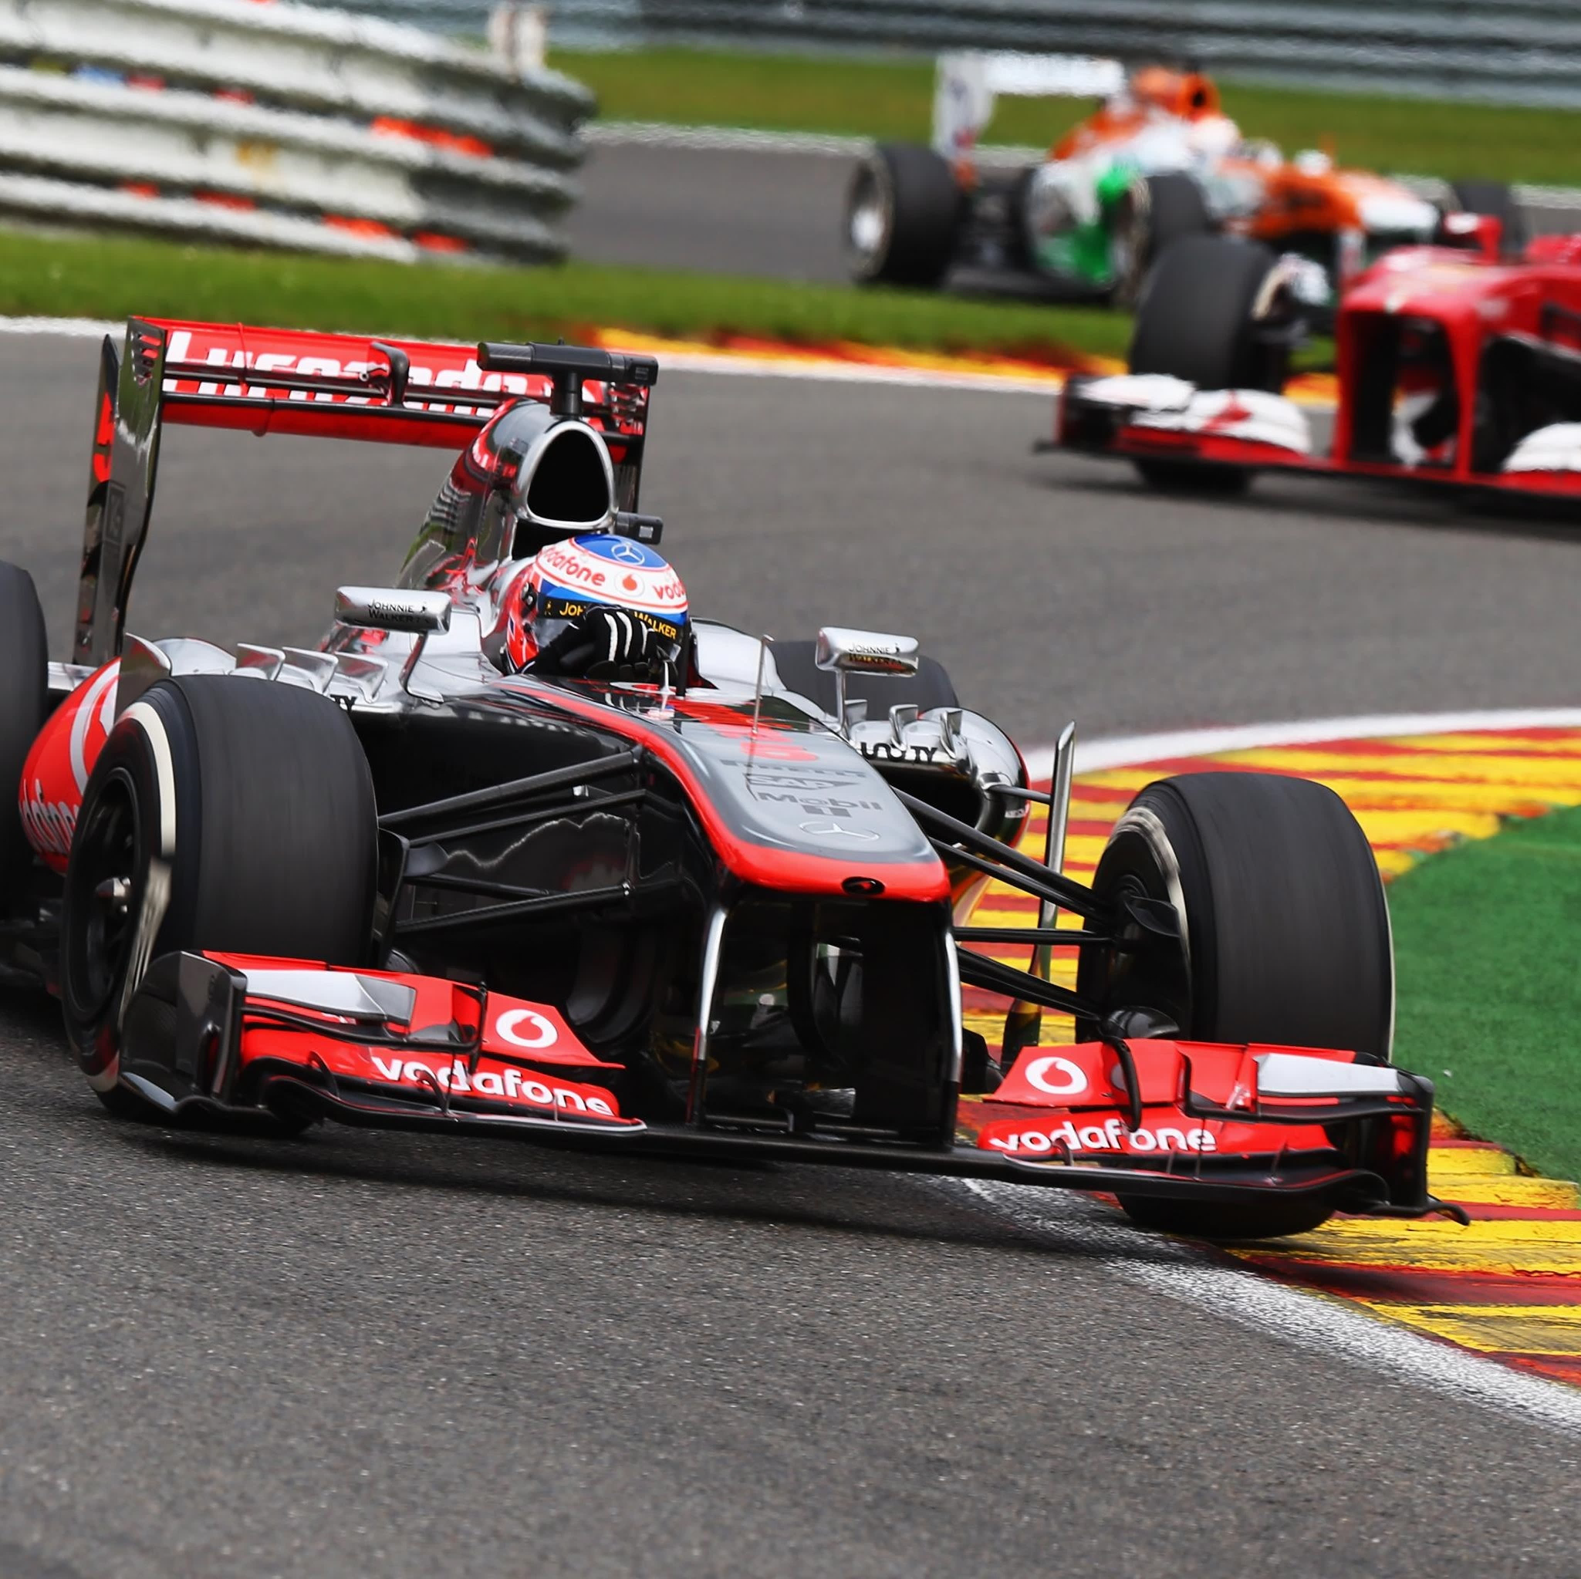
F1 Driver retention Prediction
James Murphy

Slide 2
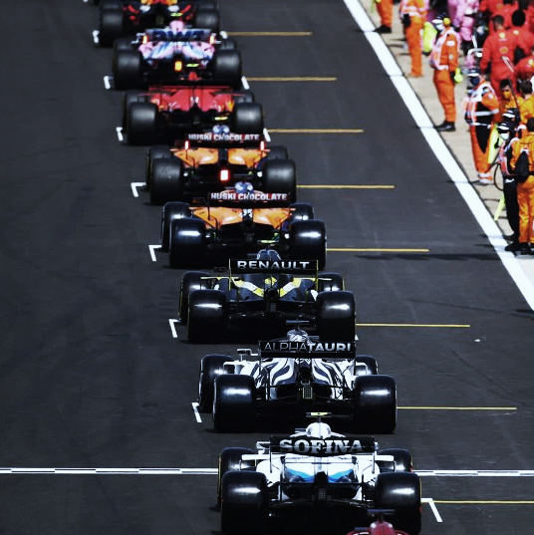
Agenda
PROJECT BACKGROUND
IMPORTANCE OF DRIVER PREDICTION
DATA CLEANING AND MANIPULATION
MODEL TUNING
MODEL OUTCOMES
CONCLUSIONS

Slide 3
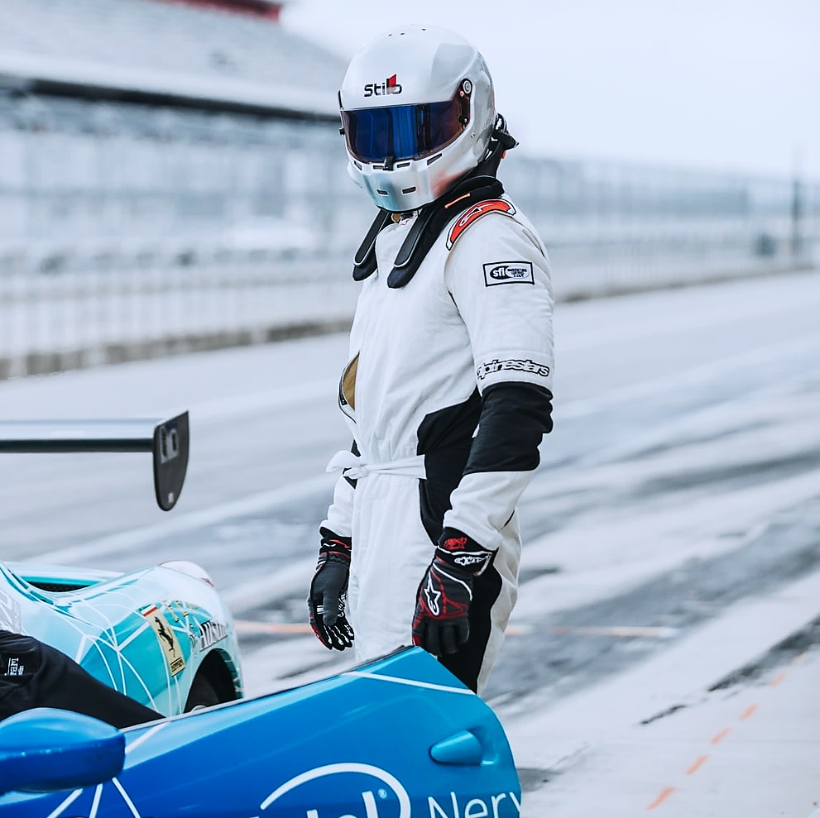
Project Background
Formula 1 is the highest class of open wheel racing
F1 World Championship contested for over 70 years
Billions exchanged in television rights and team sponsorship
Viewership at a joint all time high
2.3 million UK viewers for 2021 championship decider

Slide 4

IMPORTANCE OF DRIVER Prediction
Nearly impossible to predict a race due to extenuating factors
Making driver predictions is also important
Driver underperforming
Useful for teams to get best value
Betting markets driver transfer

Slide 5
CHALLENGES OF DRIVER Prediction
Driver kept and released based on more than merit
Internal and external politics often at play
Data not shared in public domain

Slide 6
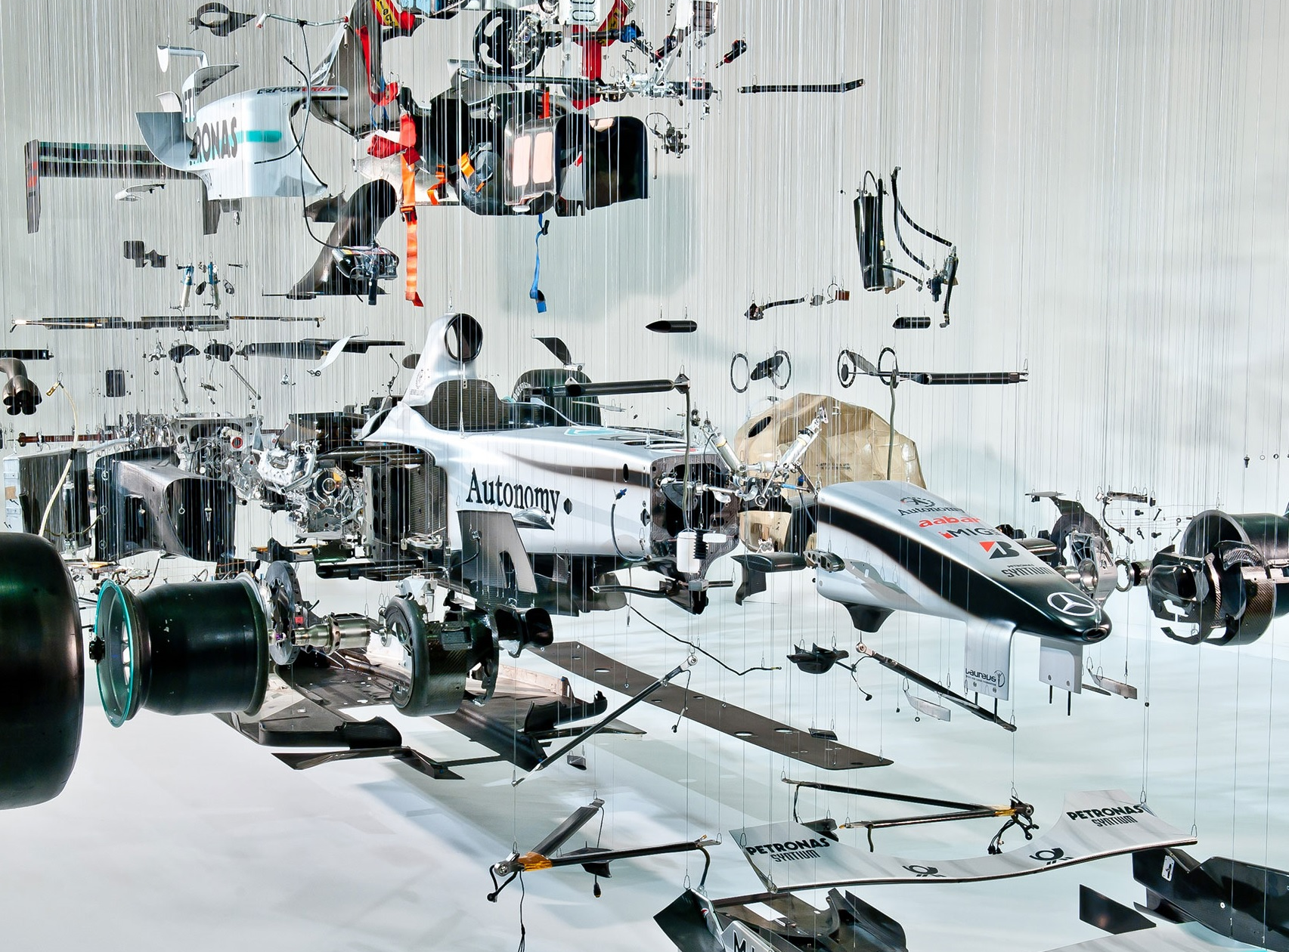
Data Cleaning And Manipulation

Slide 7
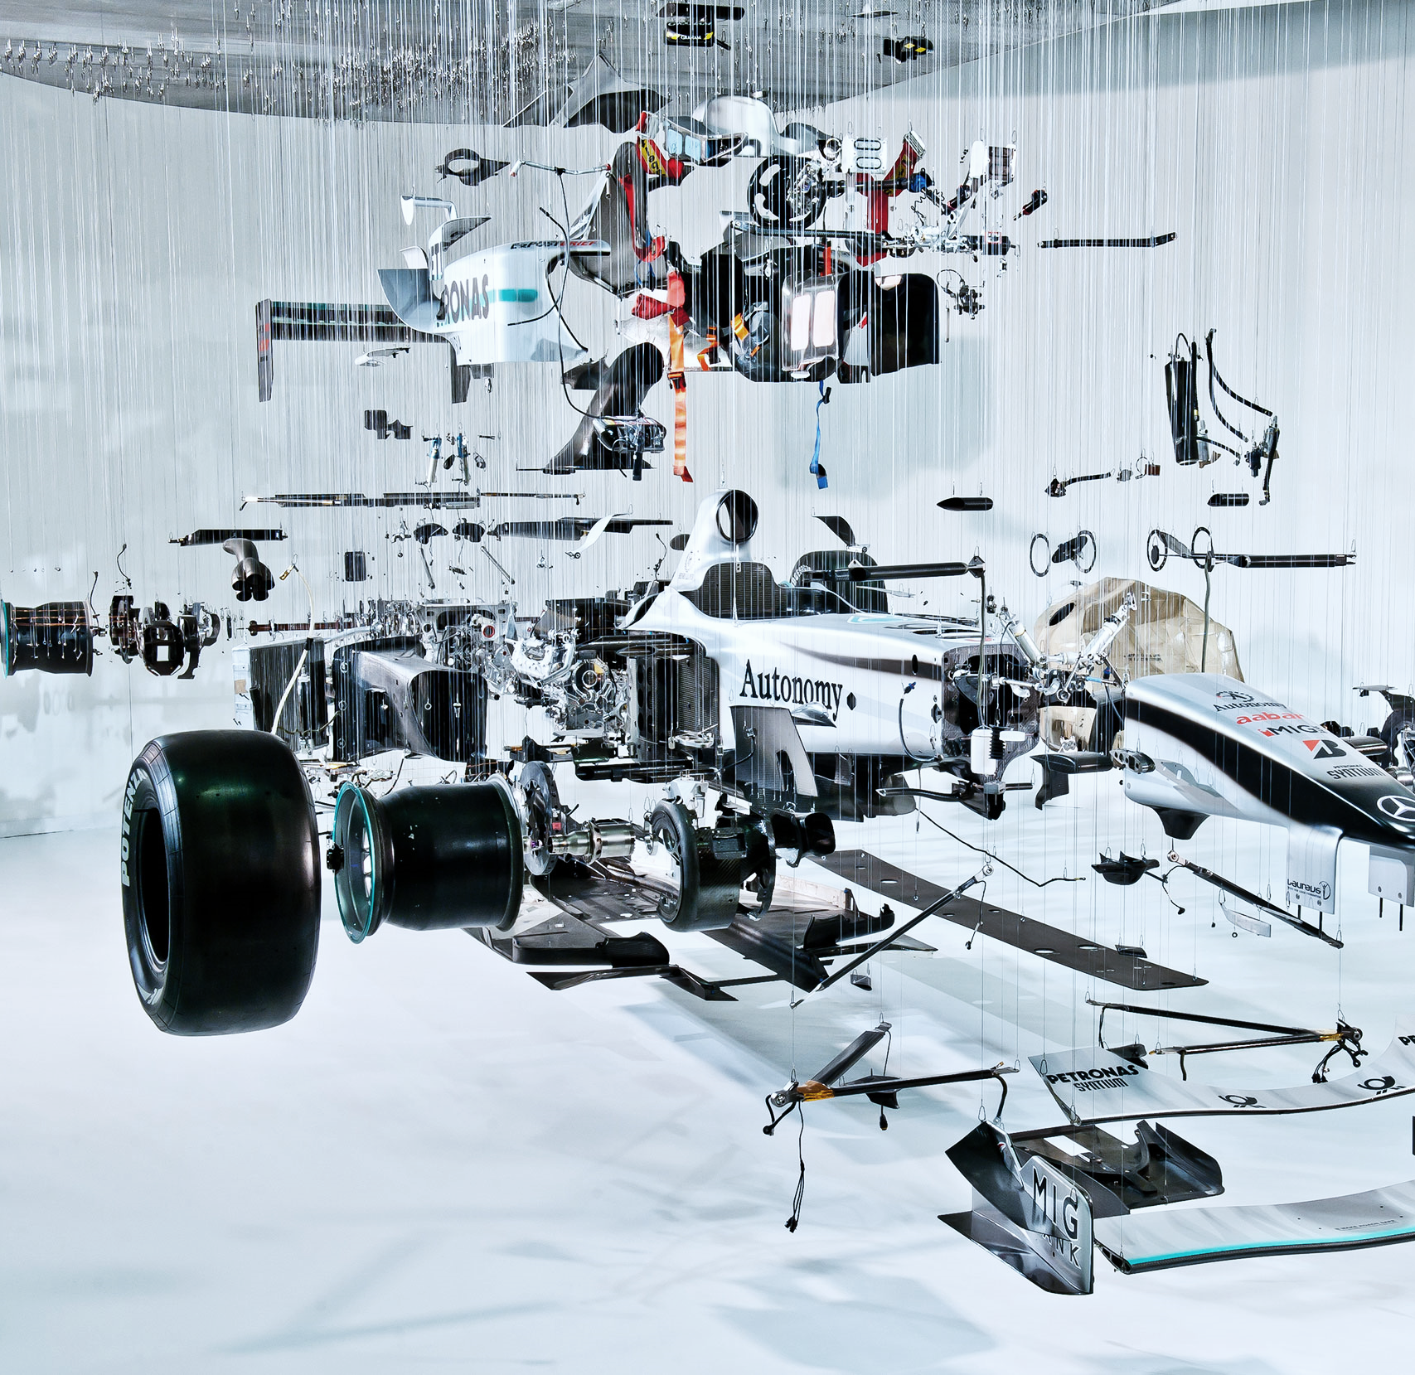
Data TARGET
Input data: drivers, races, results, standings, constructors
Data for each season compiled
Data that showed season results with multiple associated attributes
DriverID and Year ‘composite key’
Year | DriverID | Attributes | driver_move
2002 | 1 | … | ?
2002 | 2 | … | ?
2003 | 1 | … | ?
2003 | 3 | … | ?

Slide 8
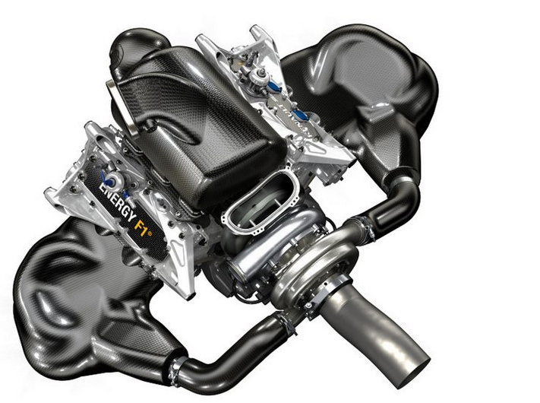
Data Observations
Earlier seasons of F1 have less uniform entry restrictions
One race drivers and manufacturers
> 100 drivers in 10 races, now 21 in 22 races in 2021
Take last 20 years of data

Slide 9
Generating “driver_move” COLUMN
No given value, can be calculated
Modal constructor for each year
Matching driver and constructor for consecutive seasons
Leaves = 1; Remains = 0
Final year data accounted for manually
481 data entries
Leave? | No. of Drivers | %
0 | 256 | 53.2
1 | 225 | 46.8

Slide 10
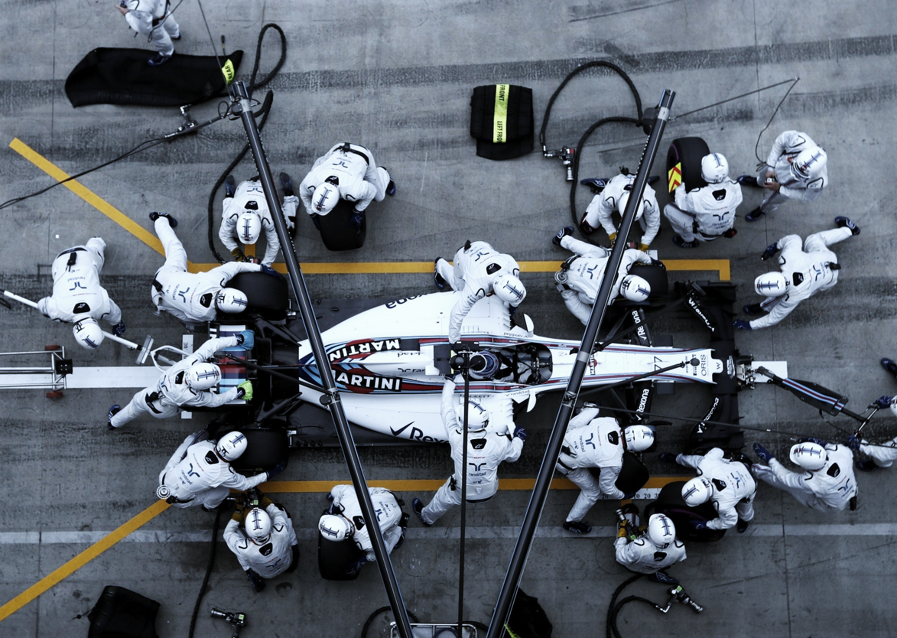
Model Tuning

Slide 11
Model Comparison
Decision trees partition features using boundaries
Node splits the data into branches
Leaf represents a decision
Random forest use decisions from multiple decision trees for output
Data overfitting common
Logistic Regression
Divides into discrete binary targets
Interpret results as probabilities of the outcome
Single decisions boundary
Data manipulation needed for continuous data
Decision Tree and Random Forest

Slide 12
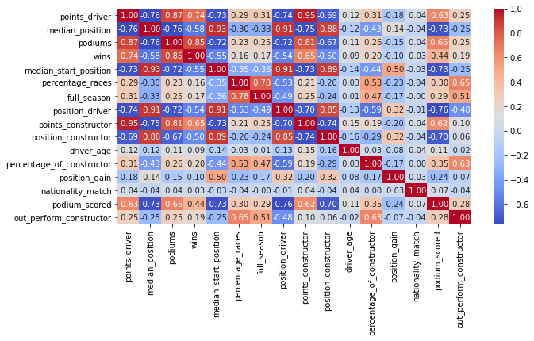
Correlation Heatmap

Slide 13
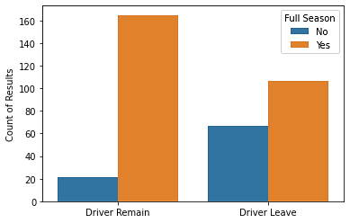
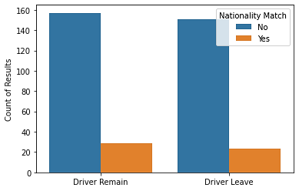


Discrete Binary Variables

Slide 14
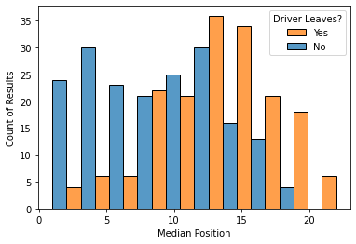
Continuous Variables

Slide 15

Model Outcomes

Slide 16
Model Scores
Model | Train Accuracy | Test Accuracy | Test Precision | Test Recall | Test F1 Score
Starting LogReg | 69.2 | 65.1 | 63.7 | 52.8 | 57.7
LogReg w/ FE | 68.3 | 71.1 | 64.8 | 68.6 | 66.7
Decision Trees | 71.9 | 69.4 | 65.2 | 58.8 | 61.9
Random Forest | 78.3 | 72.7 | 67.3 | 68.6 | 68.0
IMPROVEMENTS | + 9.1 | + 7.6

Slide 17
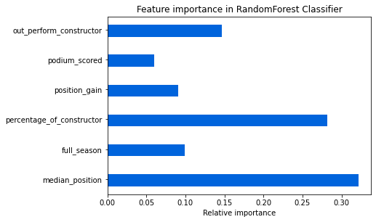
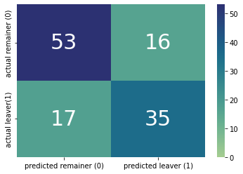
Matrix and Feature Importance

Slide 18
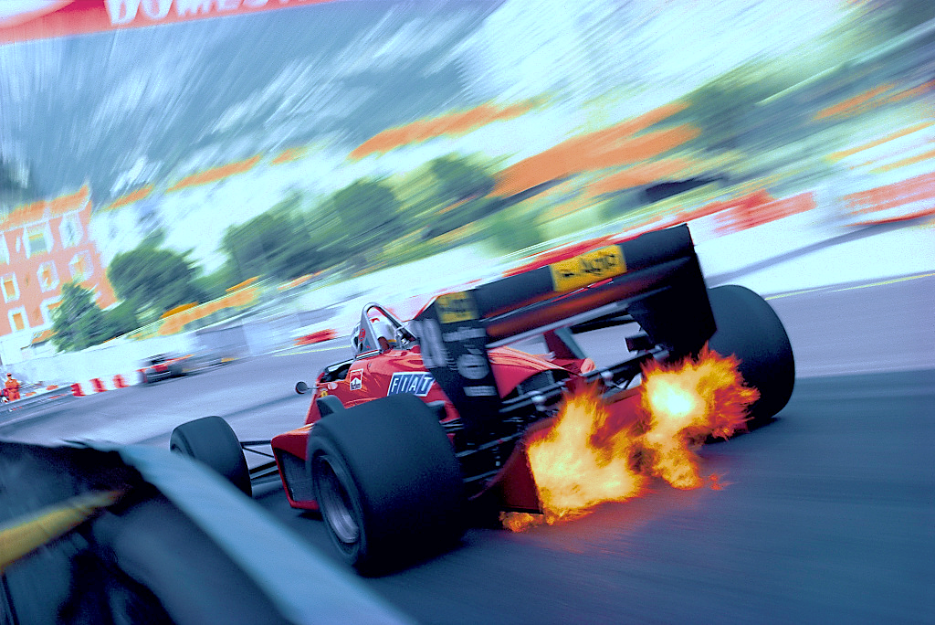
Conclusions

Slide 19
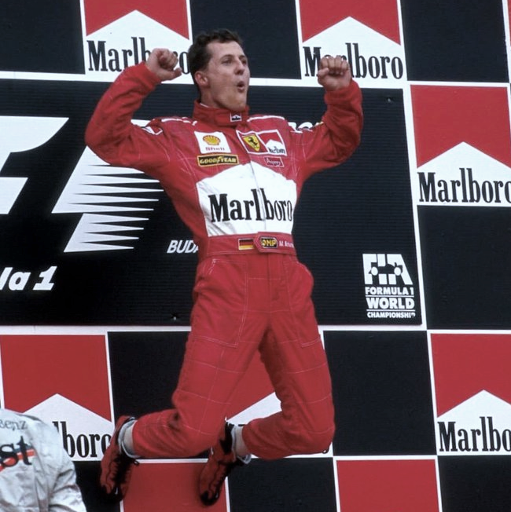
Model SUCCESSES
72.7% accuracy, aiming for around 75%
Generate positive predictions despite limited data
Solution to new data and problem
Data not overly fit

Slide 20
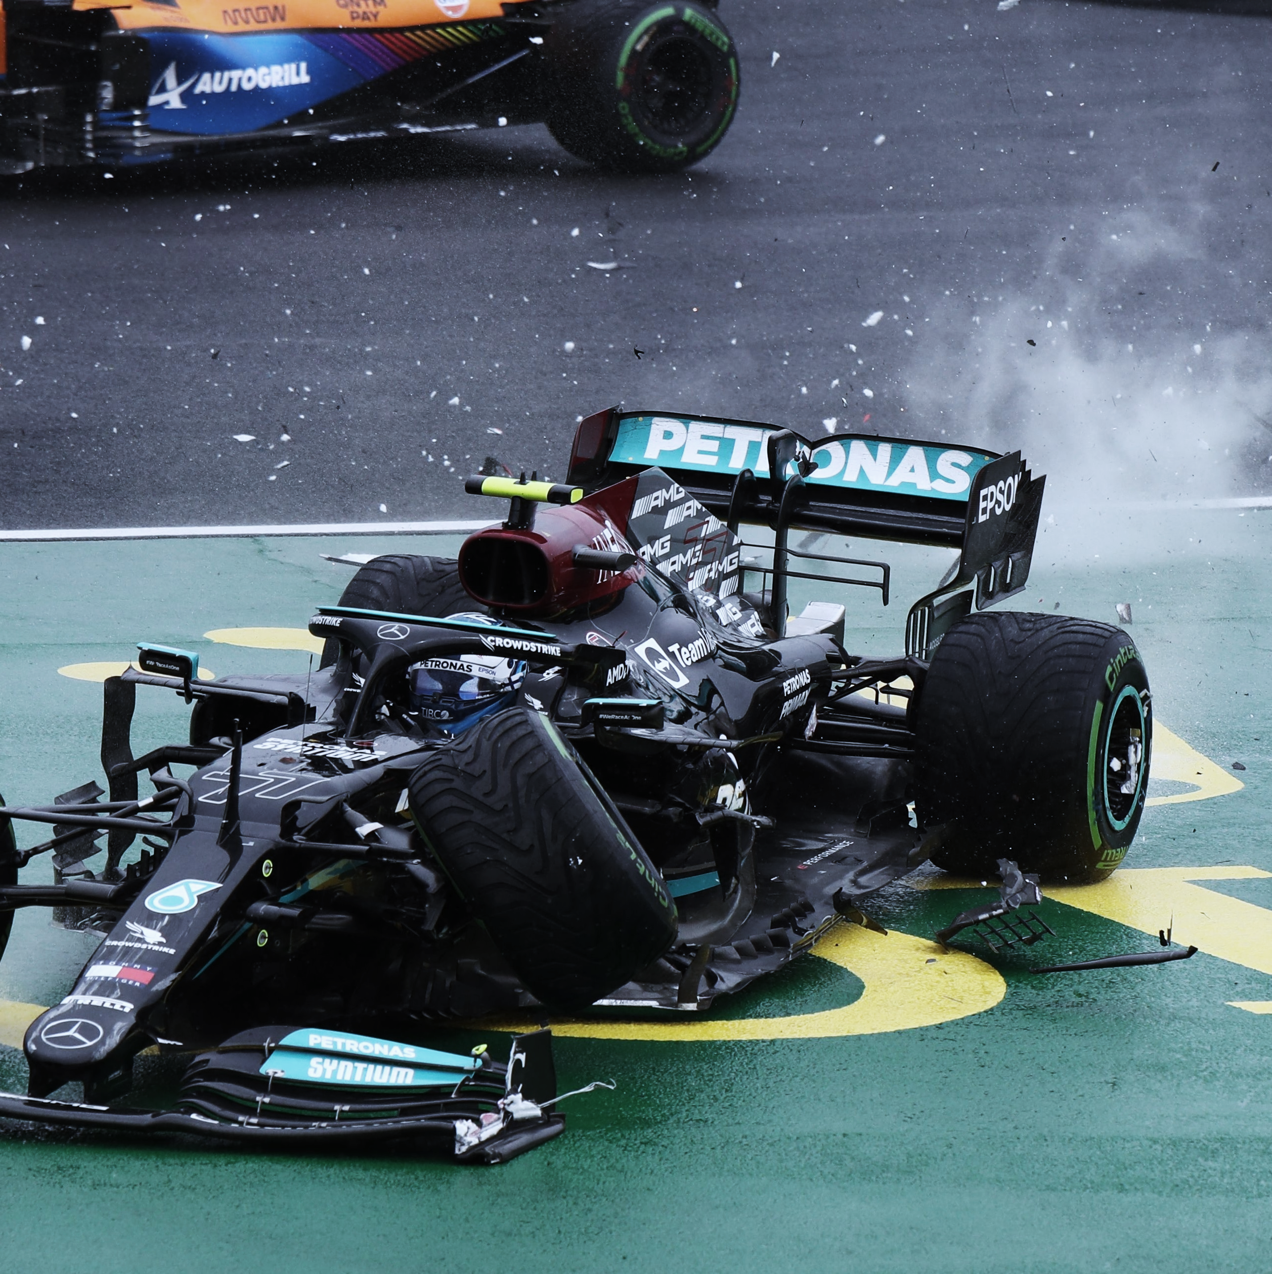
Model Limitations
Makes predictions based on a whole season’s results
Limited data to model on
481 total, 360 for train set
Reliability and schedule consistency too low pre 2000
Points system changes, affects a reliable driver success metric
New team branding recorded as driver leaving

Slide 21

Project Improvements
Identify a team name change
Further metrics to measure driver
Have a clustering or multiple outcome result
Retirement, promotion, relegation

Slide 22
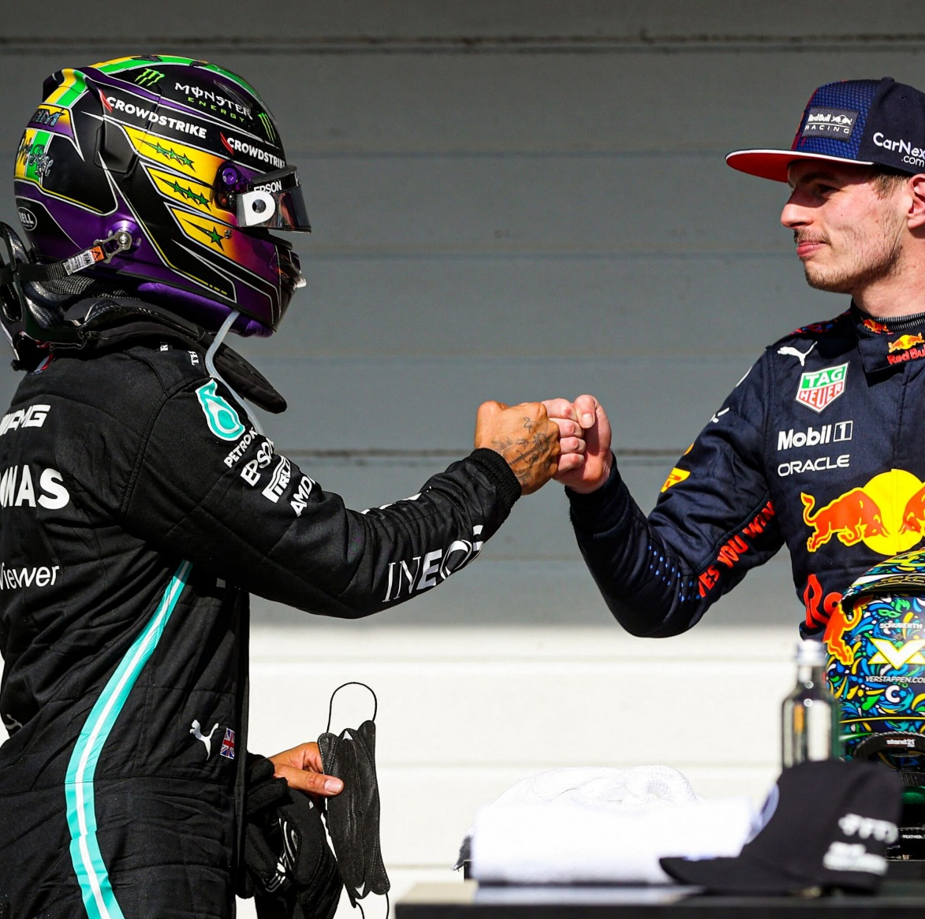
Acknowledgements
Project training and assistance
Lisa Carpenter – Data Science Training Lead
Blair Young – Data Science Instructor and Engagement Manager
Data Origin
kaggle.com/rohanrao/formula-1-world-championship-1950-2020?select=results.csv
Compiled from ergast.com/mrd
Photo credits
Title Slide: Clive Mason/Getty Images; media.bleacherreport.com
Slide 1: Bryn Lennon/Getty Images
Slide 2: clickandraces.com
Slide 3, 4: vanityfair.it
Slide 5, 6: wonderfulengineering.com
Slide 7: 2.bp.blogspot.com
Slide 9: wired.co.uk
Slide 14: Alex Treinitz/Motorsport Images
Slide 17: Motorsport Images
Slide 19: Peter Kohalmi/Reuters
Slide 20: Rainer Schlegelmilch/Motorsport Images
Slide 22: David Phipps/Motorsport Images

Slide 23
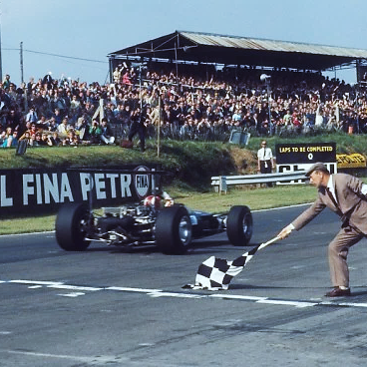
Thank you
jemurphyuk@gmail.com
www.linkedin.com/in/james-murphy-96082b173/

